Slide 1
Research Computing Update
June 2021

Slide 2
HPC Resources
New HPC – Al Mesbar cluster
A few technical issues still outstanding. These need to be resolved but we can launch service and solve at a later date.
Cluster is now with RC to install applications, implement policies, account creation etc.
Test users scheduled for second week of July
Masdar Datacentre resources HPC Cluster
KU HPC, at Masdar Datacentre, has was switched off on 3rd July.
IT was under pressure to vacate datacentre and so we had to shutdown services, before new HPC is ready for production.
All research VM’s (~50 VM’s) have now been migrated to KU datacentre. These are running on temporary resources, until procurement of RC infrastructure is completed.
Data will continue to be available from Masdar datacentre for the time being.
Only data storage platform is now running at Masdar, all other resources have now been switched off, or in the process of being switched off.
SAN HPC Cluster
As ADRIC has now been handed over to ADNOC, we have shutdown access to SAN HPC cluster on 20th June.
Research data has been migrated from that datacentre
HPC data is still being transferred.

Slide 3
Resource Utilization and Training

Slide 4
KU Cluster core distribution

Slide 5
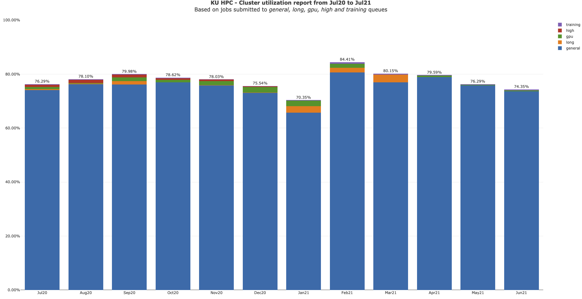

Slide 6
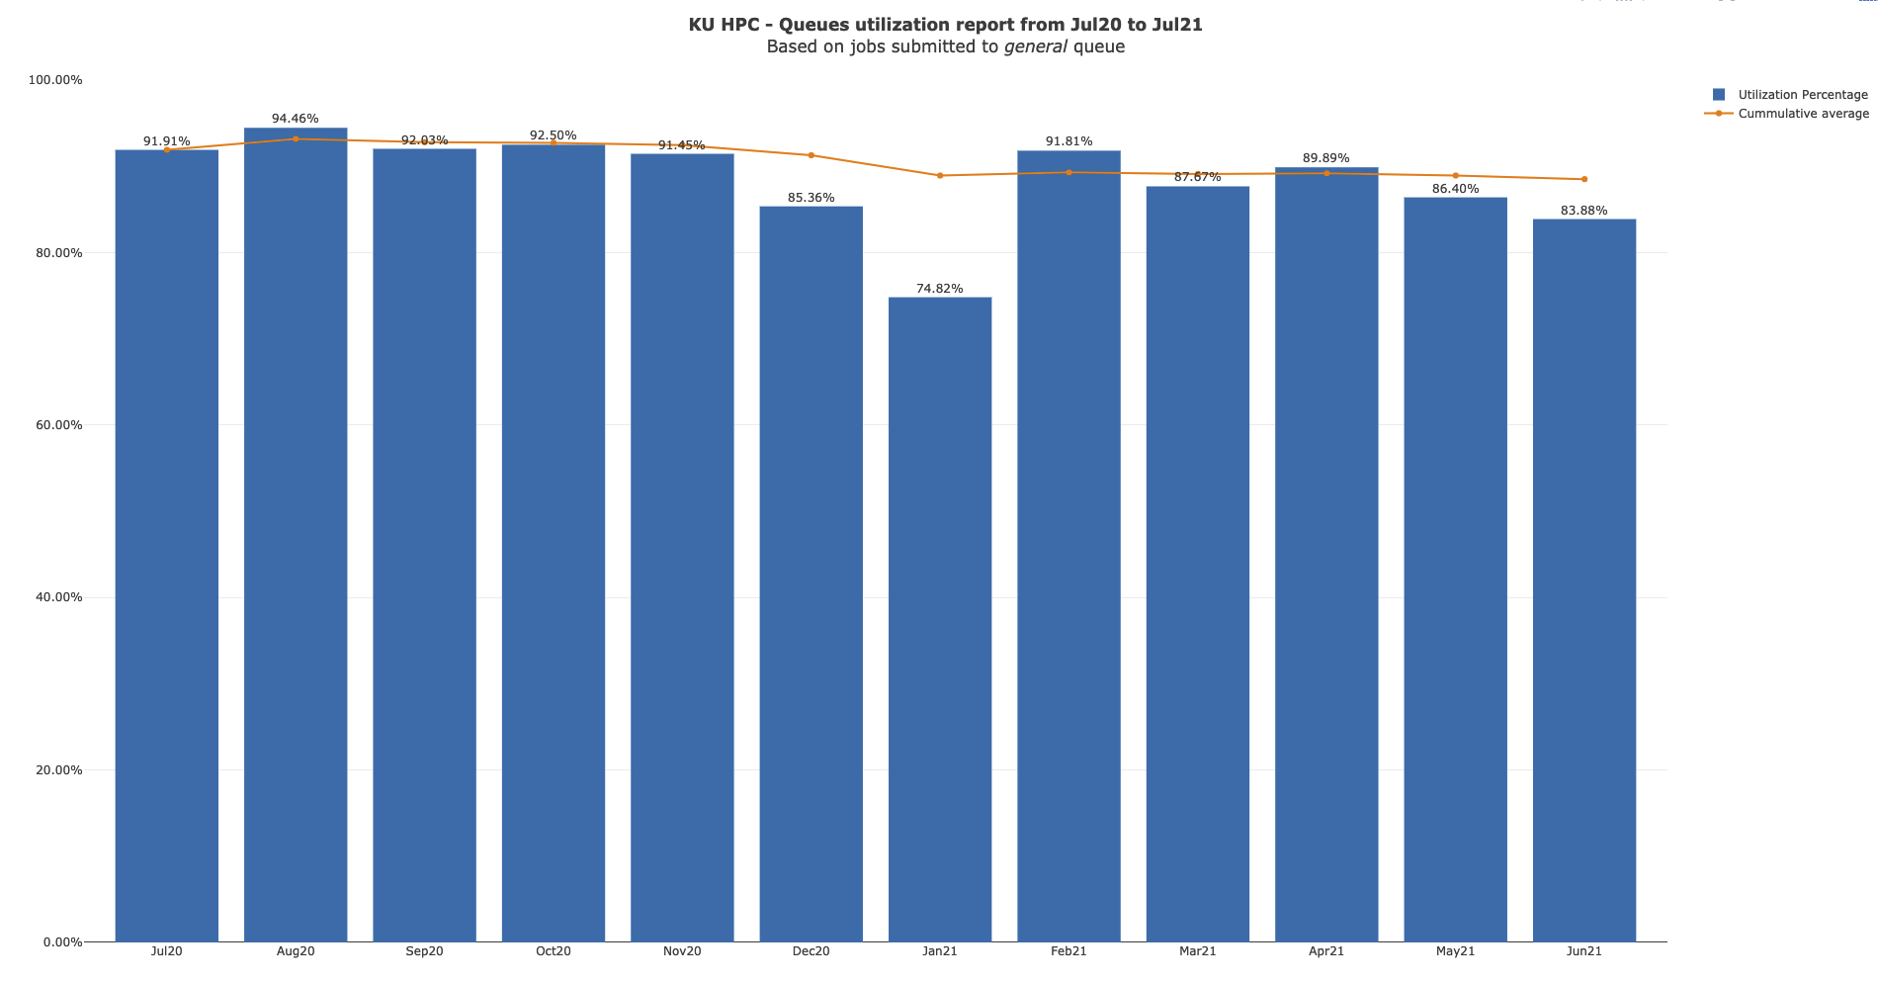

Slide 7
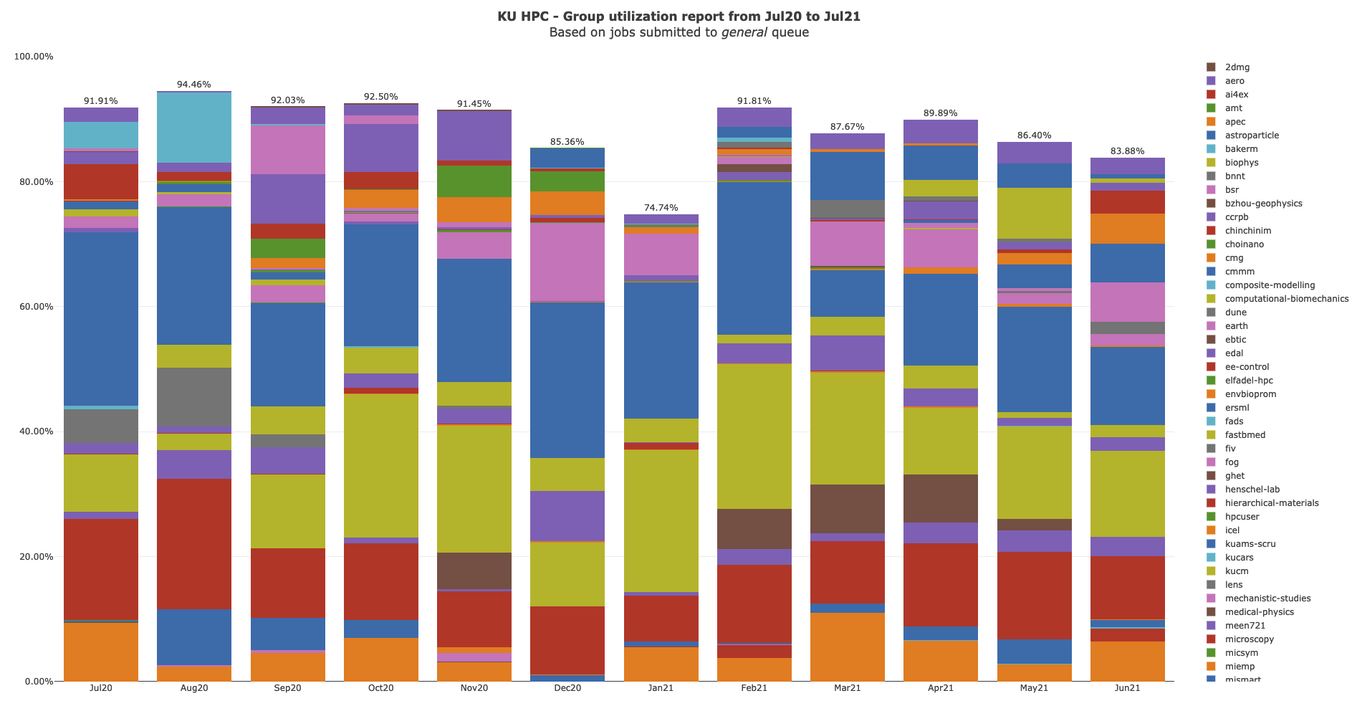

Slide 8
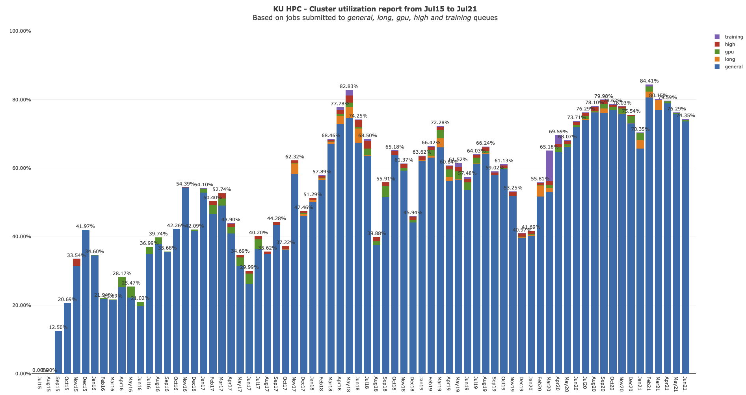

Slide 9
KU HPC Group Utilization for April 2021.
Groups were created under PI names, some of which have left KU, though the group remains. There is no link directly between HPC accounts and HR data. That is being worked on for the new cluster.

Slide 10
PI Cluster core distribution

Slide 11
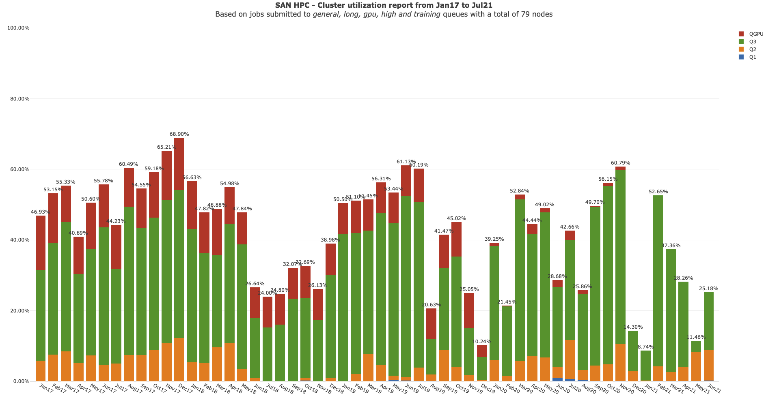

Slide 12
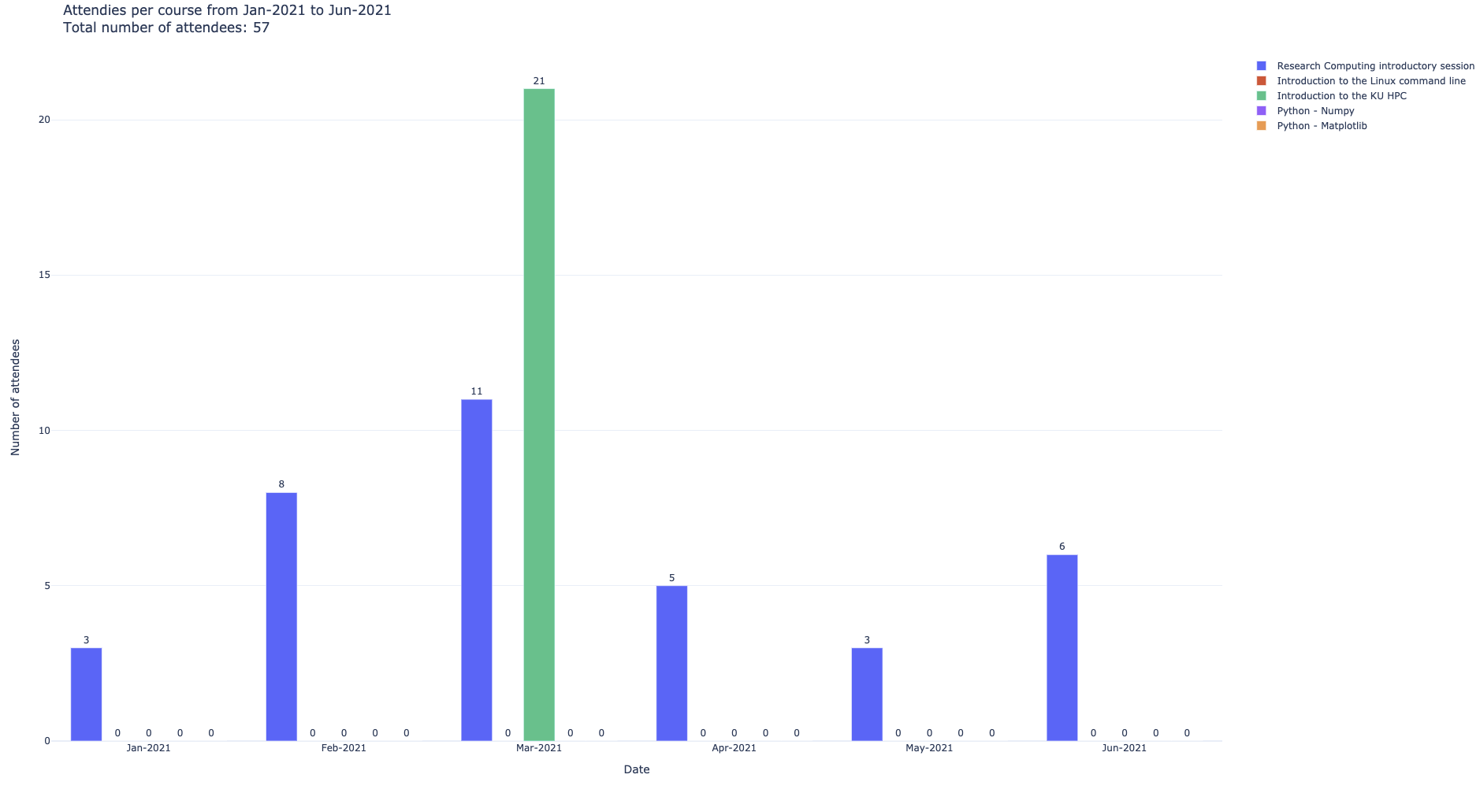

Slide 13
Status of KPI’s

